Slide 1
Representable Functors
Chapter 14

Slide 2
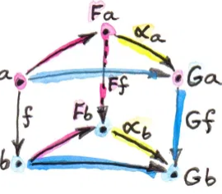
Recap
Categories
Functors (mappings between categories)
Natural Transformations (mappings between functors).
Gf o alpha_a = alpha_b o Ff

Slide 3
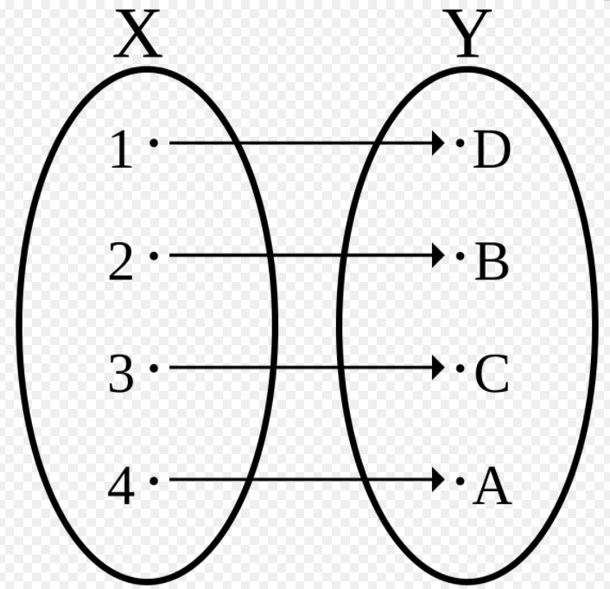
Motivation
Morphisms between any two objects in a Category, C, form a set, called hom-set, denoted C(a,b) – where a, b are the objects.
Isomorphisms (for sets) are invertible functions between them.
This means the function is injective and surjective (i.e. one-to-one and onto).
We can think of Isomorphic sets as more-or-less identical.
If such a function existed for the set of Natural Transformations and some set of Morphisms, this would mean that for every Natural Transformation in the set there is a corresponding unique morphism associated with it. We can pair the two.
We will apply this idea to isomorphisms between functors, specifically to functors isomorphic to the hom-functor.

Slide 4
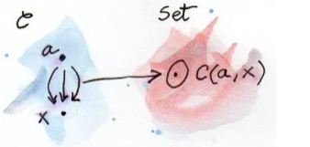
The Hom Functor
We can automatically create functors from any category to Set.
The hom-set C(a,x) is a set and therefore is an object in Set.
For each object x in the category we will get a different set. This gives a mapping that will map each object x in C to Set.
We can map morphisms, too. Let f be a morphism from x to y in C.
If the earlier mapping is to be a functor (from C to Set) then the image of f must be a function between the two sets C(a,x) and C(a,y), since x gets mapped to C(a,x) and y gets mapped to C(a,y).

Slide 5
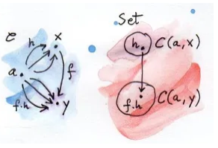
The Hom Functor (cont.)
But how will this function in Set behave? It will have a domain of C(a,x) and range C(a,y). But what else?
Let h be an arbitrary element of C(a,x). By definition h : a -> x.
Then f o h : a -> y.
This composition must belong to C(a,y), as this is a set that contains all morphisms from a to y.
This is the image of the morphism f under the mapping, i.e. the function (f o h) for all h in C(a,x).
This mapping (i.e. from C(a,x) to Set - with a fixed) is then a functor. We call it the Hom Functor.

Slide 6
Representable Functors
For every choice of an object a in C, we get a functor from C to Set.
This kind of structure-preserving mapping to Set is often called a REPRESENTATION.
More generally, any functor that is naturally isomorphic to the Hom functor is called Representable. This functor must be Set-valued (i.e. map to Set).
Functors between the same two categories (i.e. same source and target) form a category in which each functor is an object and natural transformations (between the functors) play the role of morphisms.
Two functors are isomorphic (and can be thought of as identical) if there is an invertible natural transformation between them.

Slide 7
Representable Functors (cont.)
For the functor F from C to Set to be representable we require:
An object “a” in C.
A Natural Transformation alpha from C(a,-) to F.
Another Natural Transformation, beta, from F to C(a,-).
These two Natural Transformations have to compose to give the Identity.
The component of the natural transformation, alpha, at some point x is alpha_x. This is a morphism in Set between C(a,x) and Fx.
The naturality condition tells us that for any morphism f from x to y in C, the following diagram commutes: Ff o alpha_x = alpha_y o C(a, f).
In some sense the object “a” represents the functor.
All “a”s may give you a hom-functor, but they aren’t guaranteed to give you a representable functor.

Slide 8
Haskell
Representable functors can be defined in Haskell as a class.
A functor f is representable if there is an object/type that represents it.
A functor, f, is a data type – we think of it as a container of x.
Tabulate (Rep f -> x) -> fx takes a function and gives you a data type back (like memoiziation). It’s converting a function to data.
Index fx -> Rep f -> x is taking a container and a “Key” and then returns a value, e.g. indexing the container and returning a value.

Slide 9



Haskell (cont.)
f is a function from the natural numbers.
Apply the function f to each element in the set of natural numbers. The +1 basically adds 1 to the input/natural number to the function f. So the function iterates through the natural numbers and produces a stream with this input.
Basically finding value corresponding to index in stream
Here, bs means multiple b, i.e. the rest of the stream containing objects of type b.

Slide 10
Exercises – Q1
Show that the hom-functors map identity morphisms in C to corresponding identity functions in Set.
Any Id in C will get mapped to a morphism/function in Set, since functors preserve structure. Moreover, it will be a morphism from the same object to itself because of this structure preserving property. But is it an Identity?
WTS: For any x in C, we get Id_x mapped to an identity in Set. Specifically, for any h in C(a,x), C(a,-)Id_x (i.e. the morphism Id_x under the hom-set functor) will be a morphism that maps h to h.
We know from earlier that the hom-set functor on a morphism, f, gives a new morphism in Set such that for all h in C(a,x) we have C(a,-)f := f o h.
But f here is just an identity. This means C(a,-)f : = f o h = Id o h = h for all h.
In this case C(a,-) f is just the identity, i.e. when f is an identity function it gets mapped under the hom-functor to an identity morphism in Set.

Slide 11
Exercises – Q2
Show that the Maybe functor (F) is not representable. (Recall Maybe takes an object x and maps it to Maybe x)
This is similar to the List functor he discusses about in the notes and video (36 min into it).
If it is representable there will be an invertible Natural Transformation from F to C(a,-) for some a in C.
Note that the hom-functor maps an object x to a morphism that maps a to x. Thus, we can say that C(a,-)x gives a->x, i.e., the object x is mapped to a function.
Let a be Int. Then for all x, there should be an alpha : (Int ->x) -> Maybe (x).
Similarly there should be a beta: Maybe (x) -> (Int ->x) (i.e. we take a Maybe(x) and return a function that returns x)
But with beta if we have a Nothing then we can’t get the arbitrary x out. (Similar to Empty List).

Slide 12
Exercises – Q3
Is the Reader functor, F, representable? It is.
Recall that the Reader functor is such that it takes any type x and maps it to the type a->x, for some specified a (with fmap:: (x->y) -> (a->x) -> (a->x))
In this case, if we let a be the same for both functors, we need a natural transformation alpha : (a -> x) -> (a -> x),
Which is just the Identity, which we know exists.
The same with Beta and thus the Reader Functor is Representable.

Slide 13
Exercises – Q4
Using Stream representation, memoize a function that squares its argument.
So here we have a stream represented by the Natural Numbers. Let the function, f, from a (Natural Numbers) to X (which will be our squares) be defined such that f =: x^2.
We create an instance of the stream class and apply tabulate to the function f we have just defined.

Slide 14
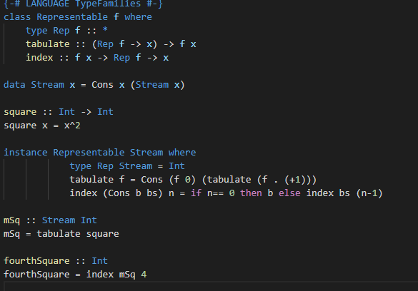
Exercises – Q4 (cont.)
Will return 16

Slide 15
Exercises – Q5
Show that tabulate and index for Stream are inverses of each other, i.e. tabulate index stream n= stream n, where stream = Cons(x0, Cons(x1,Cons(x2, …)))
(Also, index tabulate f = f for for an arbitrary function f from Int to some other data type.)
Use induction and expand out the definition for tabulate and index. Here n corresponds to the component of the stream.
Base case: n= 0
Assume true up to n= k.
Prove for k + 1
Fairly tedious, but start with:
tabulate index stream = Cons (index stream 0), tabulate(index stream . (+1))

Slide 16
Exercises – Q6
The functor Pair X = X, X is representable. Can you guess the type that represents it?
The functor takes a type X and map it to a new type X,X.
Found online: It can be represented by any type of cardinality 2, e.g. Bool.
Now the indices aren’t the natural numbers, but just a Boolean set. We look up by True or False, rather than 0,1,2, …
So Tabulate will have to take a function, say h, from Bool to a data type X, and return the functor Pair(X) (i.e. X,X).
Tabulate h = (h true, h false)
Index will have to take the pair (x,y) where x,y are both of type X and take a Boolean and then map to data type X.
Index (x,y)b = x if b= true and (x y) b = y if b is false.

